Slide 1

Hospital Readmission
Tessa Blankenship
IST 707
Professor Tin Hoang
This Photo by Unknown Author is licensed under CC BY-SA-NC

Slide 2

Analysis Introduction
In order to assure that patient’s receive quality healthcare, Medicare penalizes hospitals by lowering the amount of compensation that they receive when a patient is readmitted after a hospital stay. The object of this analysis is to find predictors that will allow the hospital to recognize when a patient has the potential of being readmitted, so that programs can be put in place to ensure that the patient receives the quality medical care that they need and prevent readmission. The goal would be to prevent the loss of revenue for the hospital by taking care of the patient at first admission.
This Photo by Unknown Author is licensed under CC BY-SA

Slide 3
Dataset Description
Data Fields – Medicare Patients - Total Observations 25,000 with 65 variables
Time in Hospital – number of days in the hospital - numerical
Number of Labs – number of labs preformed during stay - numerical
Number of Procedures – number of procedures preformed during stay - numerical
Number of Medications – number of medication that the patient is taking - numerical
Number of Outpatient – number of outpatient procedures preformed on patient - numerical
Number of Emergency – number of emergency room visits for the patient - numerical
Number of Inpatient – number of inpatient procedures preformed on patient - numerical
Number of Diagnoses – number of that the patient has - numerical
Race (Caucasian, African American) - logical
Gender (Male, Female) - logical
Age (40-50, 50-60, 60-70, 70-80, 80-90) - logical
Payer Code – the health plan that will be paying for the stay (?, MC, HM, SP, BC) – logical
Medical Specialty – the specialty of the doctor that saw the patient during the stay (?, Internal Medicine, Emergency/Trauma, Family/General Practice, Cardiology) – logical
Diagnosis – the diagnosis for the patient (diag1-3, for specific illnesses) - logical
Tests – test result for patient (max_glu_serum_None, A1Cresult_None) – logical
Medications – medications that the patient was on during the stay (metformin, repaglinide, nateglinide, chlorpropamide, glimepiride, acetohexamide, glipizide, glyburide, tolbutamide, pioglitazone, rosiglitazone, acarbose, miglitol, troglitazone, tolazamide, examide, citoglipton, insulin, glyburide-metformin, glipizide-metformin, glimepiride-pioglitazone, metformin-rosiglitazone, and metformin-pioglitazone) – logical
Change – was there a change in the patient’s diagnosis - logical
Diabetes Medication – does the patient take diabetes medication - logical
Readmitted – indicator shows if the patient was readmitted to the hospital after their initial stay - logical
Data used was found on Kaggle (https://www.kaggle.com/dansbecker/hospital-readmissions)

Slide 4
Data Preparation
The dataset had dummy variables in place and there were not any nulls
The numeric data was normalized using this formula x-MIN(x) / MAX(x)–MIN(x)
Created a logical version of the readmitted (target variable) field as well as a factor type
Training (80%) and Test (20%) sets were created and pulled based on the groups of readmitted indicator
Clustering was used for categorization of the numerical data
Training and Testing data was also used with just the normalized values

Slide 5
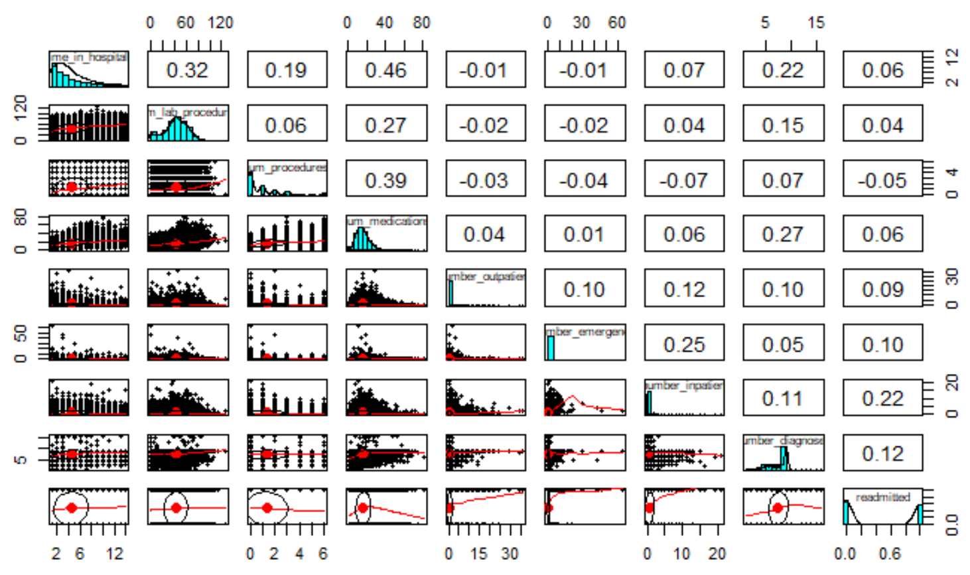
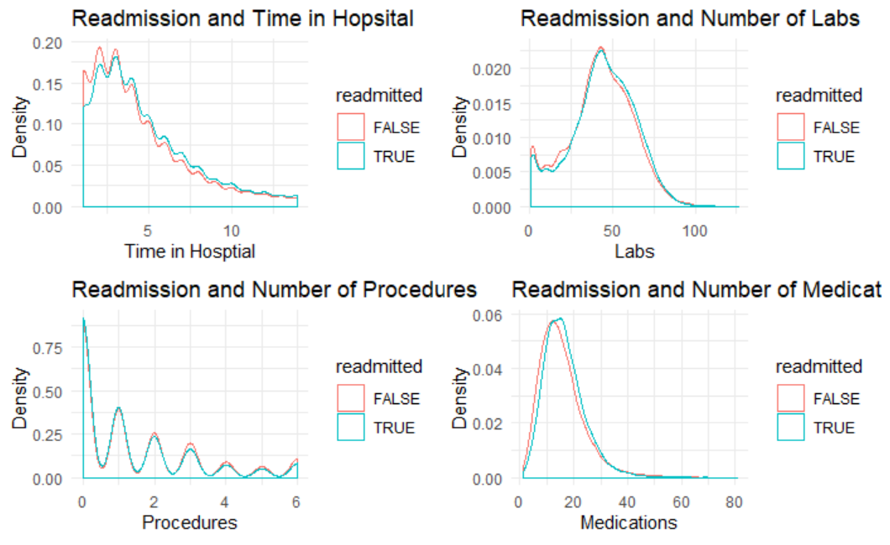
Data Exploration
Looking at the numerical data, there is only a slight correlation between the time in the hospital and the number of medications
Comparing the readmissions with Time in Hospital, Number of Labs, Number of Procedures, and Number of Medications, the trends for readmits vs non-readmits look similar

Slide 6
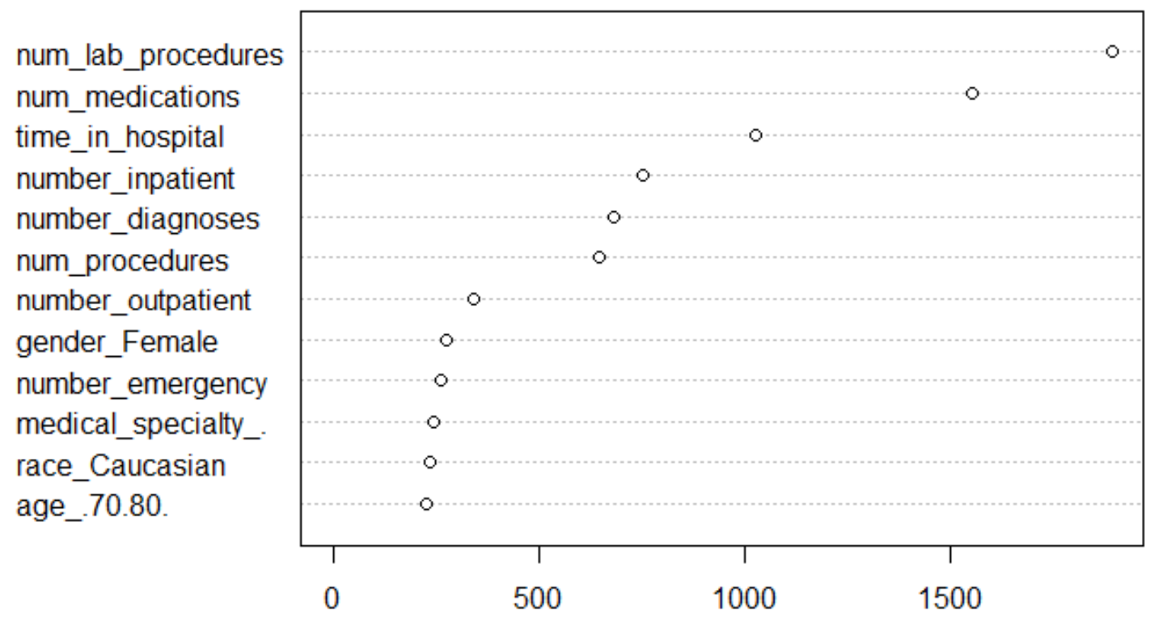
Algorithms - Unsupervised
Random Forest Decision Tree
The highest weighted variables (all numeric variables were normalized)
0.62 -0.63 Accuracy Rates
Association Rules
The top rules that resulted in readmittance
{num_procedures=[0,0.192), number_inpatient=[0.336,0.631), gender_Female, max_glu_serum_None}
{num_procedures=[0,0.192), number_inpatient=[0.336,0.631), gender_Female, glimepiride_No}
{number_inpatient=[0.336,0.631), race_Caucasian, gender_Female, max_glu_serum_None}
{number_inpatient=[0.336,0.631), number_diagnoses=[0.483,0.643), gender_Female}
{number_inpatient=[0.336,0.631), number_diagnoses=[0.483,0.643), gender_Female, repaglinide_No}

Slide 7
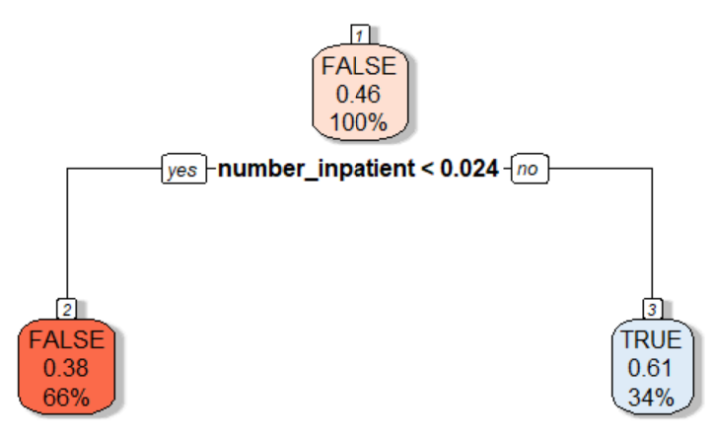
Algorithms – Unsupervised
Decision Tree
Main indicator was the number of times that the patient had inpatient procedures

Slide 8
Algorithms - Supervised
SVM Models
Linear – 0.6094 Accuracy
Polynomial – 0.606 Accuracy
Radial – 0.6086 Accuracy
Naïve Bayes – 0.6046 Accuracy
KNN – 0.5684 Accuracy

Slide 9
Recommendation
The analysis shows that while there are variables that are valuable to predicting if a patient will be readmitted to the hospital, the accuracy rates for prediction are between 56% and 63% for all of the models ran.
There may be other variables that would need to be taken into account for the best prediction.
Social-Economic Factors
Regular Doctor Visits
Regular Adherence to Prescribed Medication

